Slide 1
Funded by the European Union. Views and opinions expressed are however those of the author(s) only and do not necessarily reflect those of the European Union or the European Education and Culture Executive Agency (EACEA). Neither the European Union nor EACEA can be held responsible for them.
SPACE*LAB Erasmus+ Project 2021-1-IT02-KA220-SCH-000032535
SPACE*Lab
Blended Training course for primary teachers

Slide 2
How can we implent STEAM in class?

Slide 3
STEAM is a process of application. It allows students to create meaning for themselves and the others
Students and Teachers engaged in STEAM make more real-life connection; school is not the place of learning anymore, but the learning experience itself.
Teachers may implement STEAM with Project based learning.

Slide 4
STEAM Learning is inquiry based, as it is PBL
STEAM and PBL
Questions are driven by the learners, and failure is reframed as part of the learning process
Teachers may implement STEAM with Project-based-learning.
What PBL and STEAM do have in common?
Goals, decisions, and solutions are generated by the students
Students control their own investigation
For the inquiry to be authentically STEAM it should result in a product that provides a solution to a real problem

Slide 5
If students can address real problems in their social and environmental context, they will be able to make the connections between STEAM knowledge and their impact on everyday life.

Slide 6
What is PBL?
Project Based Learning is a teaching method in which students gain knowledge and skills by working for an extended period of time to investigate and respond to an authentic, engaging and complex question, problem, or challenge.

Slide 7
Let's watch this video!

Slide 8
To sum up...
Students have to solve a real-life problem
They do researches and together find a solution to the inquiry.
They combine their previous knowledge with their researches and with what they are learning
Students present their solution to an audience

Slide 9
PBL is:
Interdisciplinary
Challenging
Connected to real-life
Self-Directed

Slide 10
The teacher in PBL
The teacher is Always present! The teacher is a Guide on Side, that follows students' progresses!
The teacher checks on and follows students learning and sources.

Slide 11
The Driving Question
A driving question is presented as the frame for the project.
A good driving question is one that “focuses all other questions towards a solution or product”
It is open-ended
It engages high-level thinking
It requires students to synthesize information from multiple sources, experiences, and activities

Slide 12
A good driving question is:
Open-ended enough to allow individual investigation
Relevant and meaningful to students
Support self-directed learning
Involves authentic problem-solving
Lends itself to cross disciplinary work and collaboration

Slide 13
A driving question can be...
Exploration of a philosophical question
When do we grow up?
Who has power and how do they get it?
An investigation of an historical event or time period
Was it necessary to get Americans involved in the Vietnam war?
What do we know about life in East Germany before unification?
A problem solving situation
How can we improve traffic flow in our city?
What should we do about the cold lunches in our school cafeteria?

Slide 14
A driving question can be...
Examination of a controversial issue
Should the population have access to handguns?
Should religion be taught in schools?
Is war ever justified?
A challenge to design, create, or produce something
How can we create a mural that represents our community’s past and present?
How can we design a website to share our poetry with the world?
How can run a successful book club at our school?

Slide 15
Activity
Write your own Driving question:
Choose one of the propposed driving question
Formulate your own driving question following the example
take into consideration your subject

Slide 16
PBL: The Lego challenge!

Slide 17
STEAM and
Design Thinking

Slide 18
Design Thinking Process
Design Thinking is a design methodology that provides a design-based approach to solving problems
The Design Thinking is a powerful approach to get students to think both critically and creatively.
Using a structured framework, students identify challenges, gather information, generate potential solutions, refine ideas, and test solutions.

Slide 19
Design Thinking

Slide 20
Design Thinking & STEAM
Design thinking process connect real-world problem solving with classroom environments. STEAM makes connection between content and real life problems.
A design thinking approach focuses on developing students’ creative confidence. This is also what STEAM does.

Slide 21
Design Thinking
Teachers and students engage in hands-on design challenges that focus on:
developing empathy
developing metacognitive awareness
promoting initiative
fostering active problemsolving
encourage creativity

Slide 22
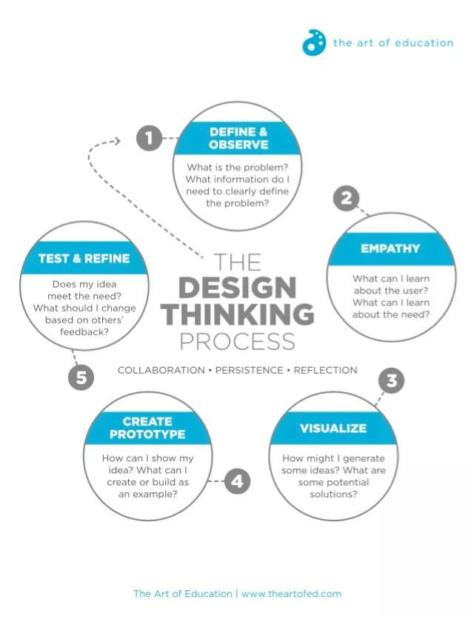
How does it work?
It comes down to five essential question:
Defining/observing
Empathizing
Visualizing
Creating prototypes
Testing/refining

Slide 23
Design Thinking
Help Students develop an innovator's mindeset
connect what students learn in class to real world challenges
foster problem-solving
makes student collaborate and work with each other
helps students build empathy
makes student feel empowered
foster the kind of creative thinking and solution-thinking required in 21st century society.

Slide 24
Activity
Design a Board game!

Slide 25
Assessment for STEAM learning
There are many aspects of STEAM learning that you may want to assess, including:
student persistence
improvement progress
meeting of curriculum objectives
collaboration and teamwork
content knowledge
content application
design success

Slide 26
The assessment can be:
Teacher assessment
Peer assessment
Group assessment
Self-assessment
What about students assessing teachers?!

Slide 27
How to do formative assessment in a STEAM class?
Learning Journal
Rubrics
Portfolios
Round of oral feedback
Anonymous written feedback
Two stars and a wish
Venn diagram
Quizzes

Slide 28
The STEAM learning Journal

Slide 29
The STEAM learning Journal
It is a place where to record everything that happens during the STEAM class. Students can record ideas, datas, observation, discoveries, design sketches, and more.
It provides student with a place to reflect on their learning through drawing and writing

Slide 30
The STEAM learning Journal
Formative assessment: Students reflect on their own learning. Ask your students to share them in a group discussion periodically.
Summative assessment: score the learning journal periodically with a single-point rubric.

